Slide 1
Making the best use of health evidence in policy making
The role of evidence and expertise in effective policy making: linking transport, health and well-being
4 December 2015, CSaP professional development policy workshop
Notes:
Size of the UK economy is £1,500bn
Health and care is around 10% of this….so £150bn
To achieve a 1% growth in the UK economy would mean a £15bn increase in GDP
If health and care contributed its ‘fair share’ towards this it would need to contribute an extra £1.5bn next year
And an increasing amount over future years as the economy grows
[insert conclusion of work so far]

Slide 2
Overview
How do policy makers make the best use of evidence?
      Triangles and circles
What counts as evidence?
3. Live issues linked to health impacts of transport and travel:
      Noise
      Accidents
      Air quality
      Obesity/increasing physical activity

Slide 3
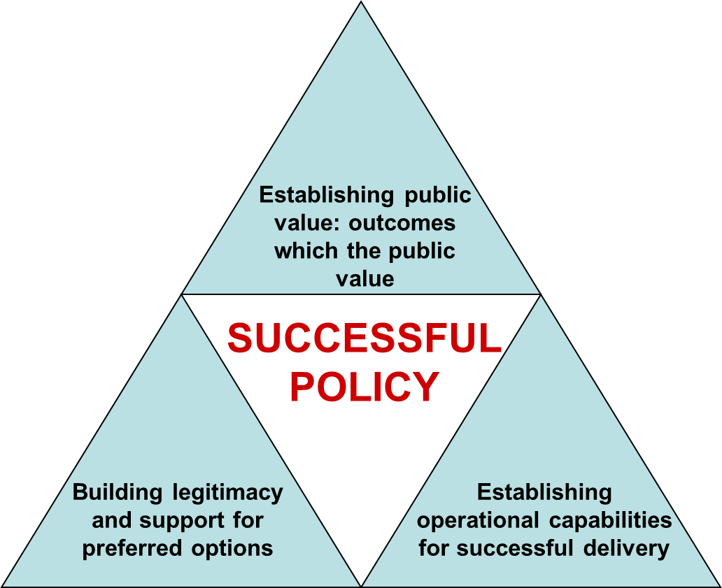
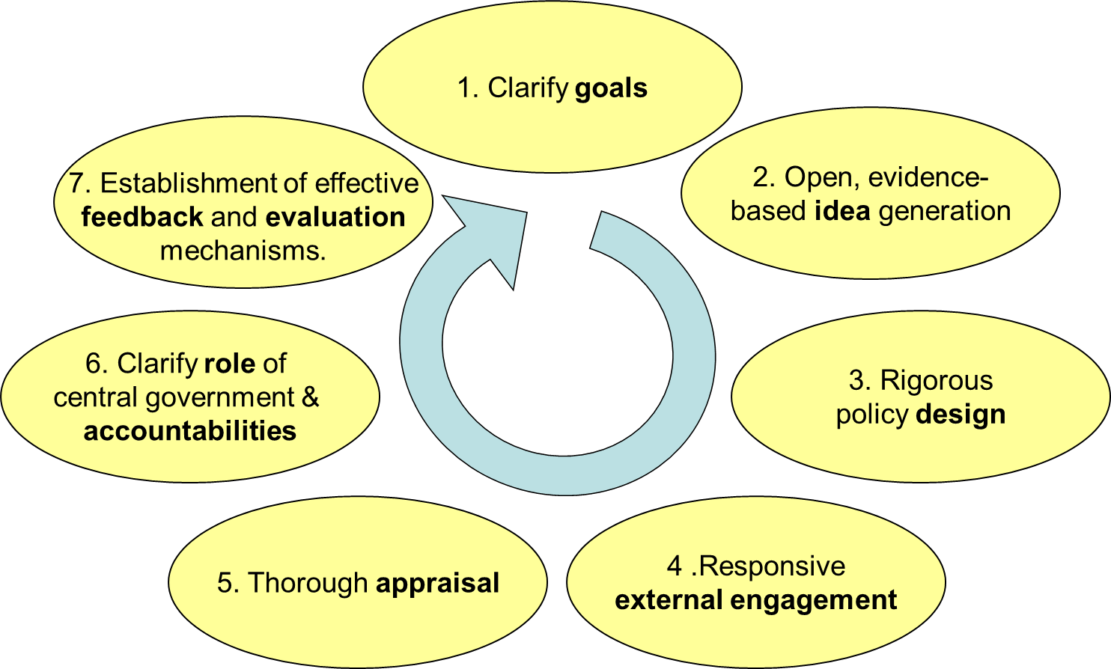
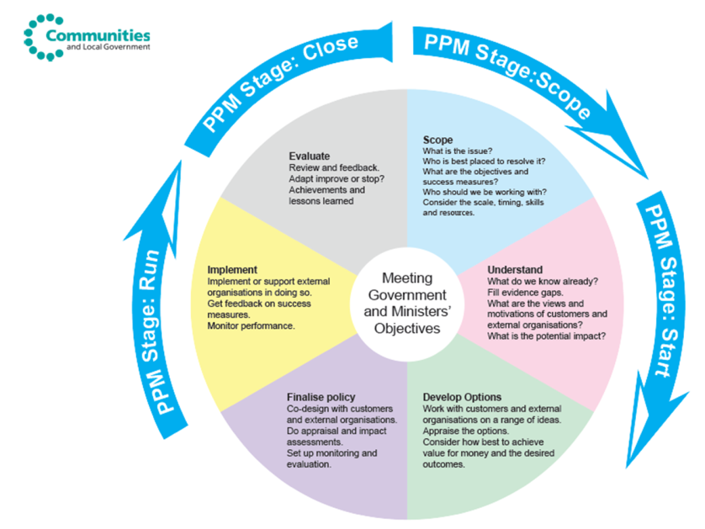
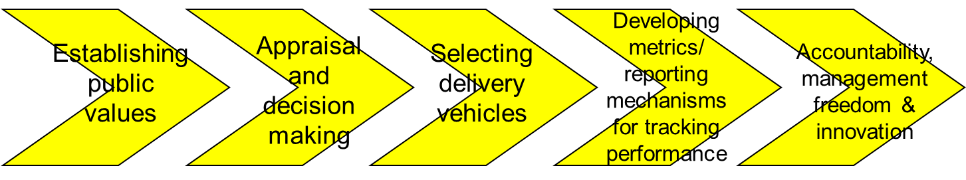
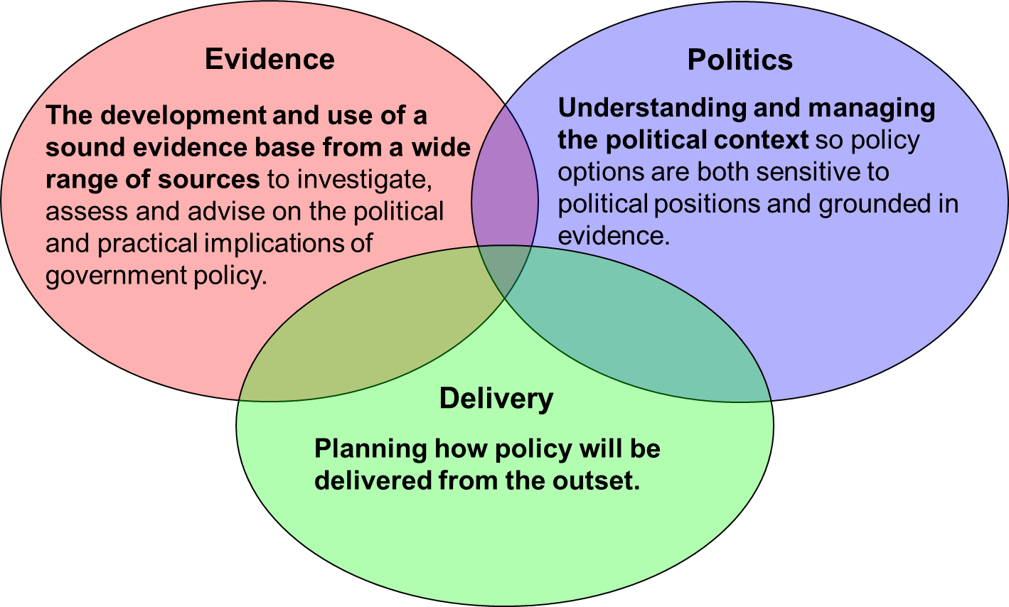

How do policy makers make the best use of evidence?

Slide 4
In summary….
Define Problem
Develop Policy Options
Deliver and Evaluate

Slide 5
Types of Research Evidence
Experimental
Quasi-Experimental
Counterfactual
Experimental
Quasi-Experimental
Qualitative
Theories of Change
Social Ethics
Public Consultation
Surveys
Admin Data
Comparative
Qualitative
Implementation Evidence
Ethical Evidence
Descriptive Analytical Evidence
Cost-Benefit
Cost-Effectiveness
Cost-Utility
Econometrics
Impact Evidence
Surveys
Qualitative
Economic and Econometric Evidence
Attitudinal Evidence
Statistical Modelling
Multivariate
Analysis

Slide 6
Transport, Health and Wellbeing
Transport’s
Impact on Health What Impact and How
Accidents - Death/Injury
Emissions - Disease
Noise - Wellbeing/Mental Health
Fitness (DH) - Disease
Jobs - Wellbeing
Linking Health and Wellbeing and Transport policies can…
Reduce Deprivation
Reduce Health Inequalities
Improve Productivity

Slide 7
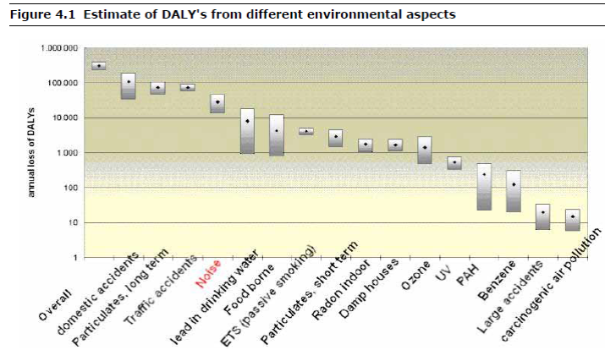
Noise – emerging evidence
Noise may be an under-estimated source of morbidity and mortality.
An assessment by a Dutch research organisation was the reported by EU as below.
The CAA has reviewed evidence about effects on health under contract to Defra.
Defra analysis is also steered by a cross-Whitehall group (IGCB(N)).
The evidence base is emerging, but noise and poor air quality tend to be correlated, so their effects can be difficult to disentangle.
Source: http://www.eea.europa.eu/publications/good-practice-guide-on-noise

Slide 8
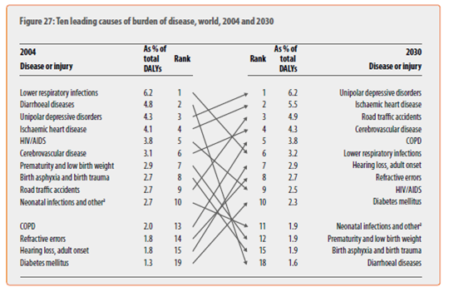
Accidents – evidence could be improved
Road traffic accidents the world’s 3rd largest cause of lost quality and length of life (ie DALYs) by 2030
DfT lead on this for the UK. An important benefit is the value that people attach to fewer accidents. DfT has a well-established methodology
DfT values for preventing fatalities are widely used across government. Includes valuation of reducing accidents – and also about physical activity impacts
OECD are undertaking modelling of the health impacts and cost-effectiveness of interventions to reduce drink-driving mortality and morbidity, as part of their alcohol policy modelling
Evidence base is relatively good, but there are gaps and areas where the evidence could be improved.
Source: WHO

Slide 9
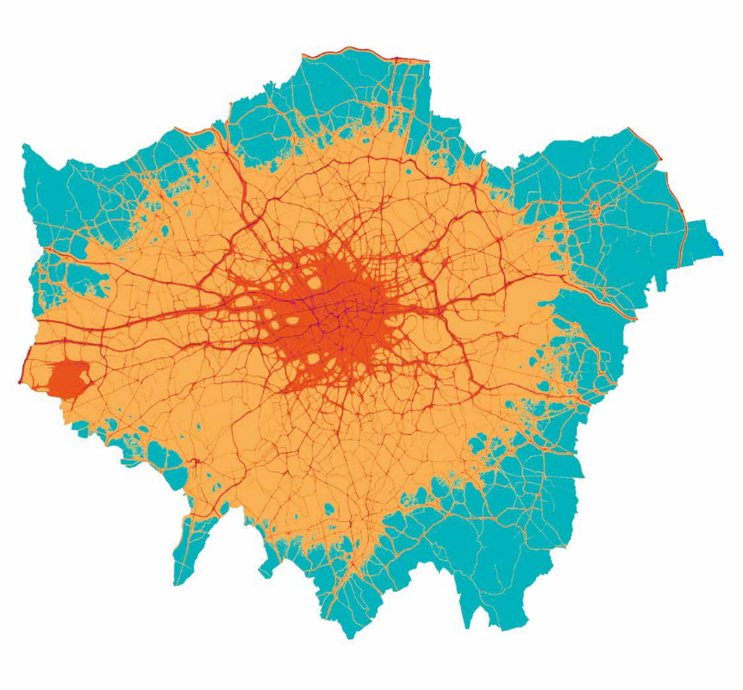
Air Quality – evidence base relatively good
Current EU legislation limits particulates in atmosphere that countries have to meet - supposed to met in 2010, or 2015 if an extension was agreed with the EU
Compliance is expected in all UK zones by 2020, apart from Greater London, where compliance would be projected by 2025
Defra are leading work which includes cost-benefit analysis of measures to reduce NO2, such as new clean air zones
Many evidence links in the chain:
    epidemiological data on the impacts of different levels of NO2 on morbidity and mortality (including the difficulty of partitioning impacts into those caused by NO2 and those caused by particulates);
    sources and causes of emissions;
    impacts of policies on emissions; and then
    impacts of policies on health.
Expert epidemiological evidence is provided by COMEAP (a DH expert committee), modelling is undertaken by consultants under contract to Defra. The CBA is steered by a cross-Whitehall group, IGCB(AQ)
The evidence base is relatively good, but there are lots of gaps and areas where the evidence could be improved
Source: Kings College, London

Slide 10
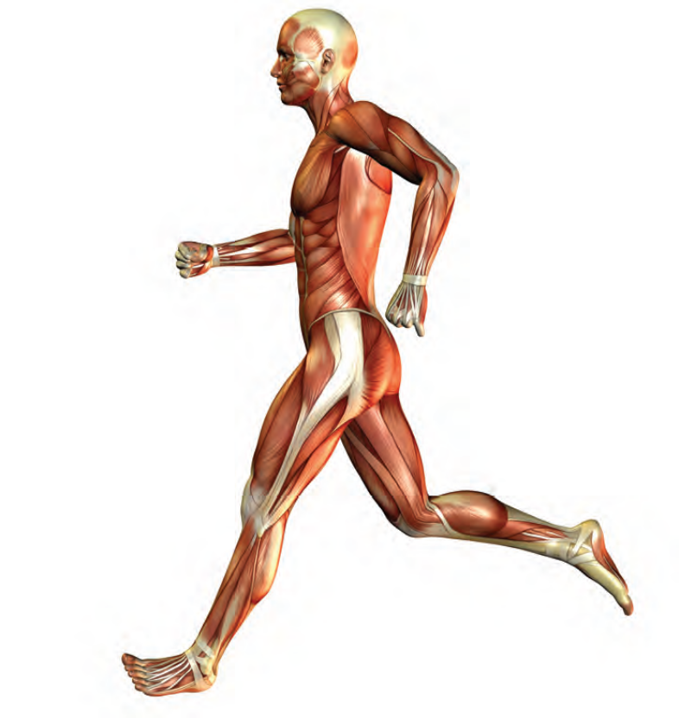
Obesity/increasing physical activity – evidence good
The importance of action on obesity is established “Healthy Lives, healthy people” 2011
UK government Foresight report “Tackling obesities: future choices” remains the most comprehensive investigation into obesity and its causes. Complex problem that requires action across society.
Regular physical activity helps to prevent obesity and excess weight. Over a third of adults are not active at recommended levels.
Extensive evidence base for effective action on active travel – NICE local measure to promote active transport.
Research on barriers to cycling and walking influenced working across LA in Leicestershire
Evaluation – e.g. Cycling Demonstration Towns Programme. Benefit cost ratio of at least 2:1

Slide 11
Summary
Policy making is not linear or simple. Generally involves defining the problem, developing options and delivery and evaluation
Evidence needed at all stages
Don’t confine evidence to any specific type
The strength and robustness of the evidence base varies – we have to live with that
Evaluation and cost-benefit analysis is increasingly desirable

