Slide 1
Environmental factors in transport project commissioning and approval :
From evidence to influence
Vicky Robb
4 December 2015

Slide 2
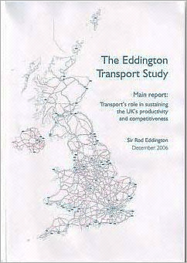
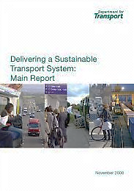
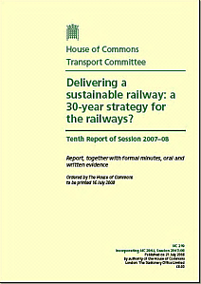
Setting the framework – transport planning and delivery goes beyond a single Parliament timescale

Slide 3





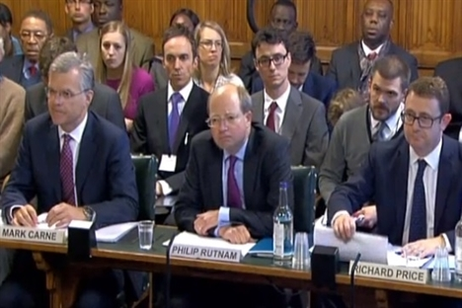

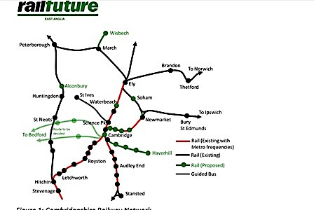

Are multiple departments involved, delivery stakeholders, and wider interested parties in transport project appraisal and scrutiny

Slide 4
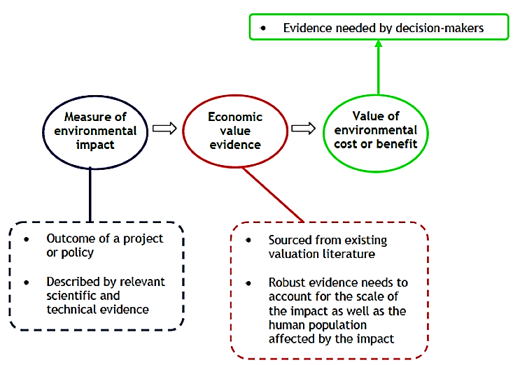
Following .gov.uk guidance on environmental considerations in project appraisal is important for ‘usability’ in decision making
HMT Green Book
www.gov.uk/government/publications/the-green-book- appraisal-and-evaluation-in-central-governent
DfT TAG guidance
www.gov.uk/guidance/transport-analysis-guidance-webtag
Defra Accounting for environmental impacts www.gov.uk/government/uploads/system/uploads/attachment_data/
file/191500/Accounting_for_enviornomental_impacts.pdf
DECC Carbon Valuation
www.gov.uk/government/collections/carbon-valuation--2

Slide 5
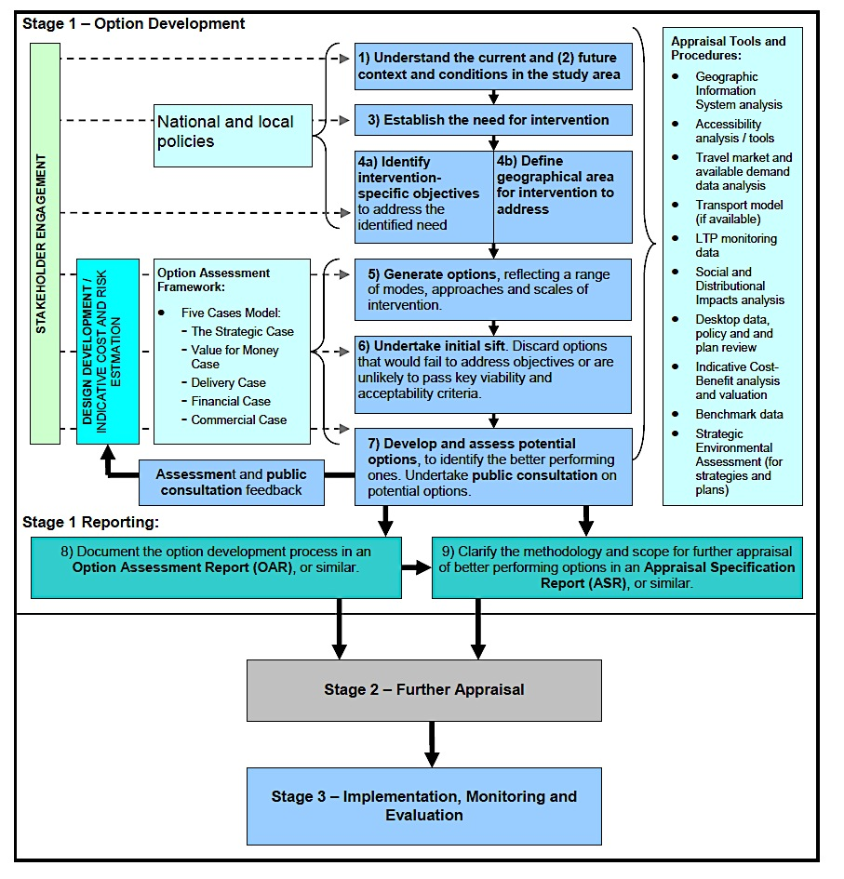
That said, environmental considerations are important but one of a large number of potentially competing inputs.
Important research findings and data fed in as early as possible
Source: DFT TAG guidance

Slide 6
Treasury five part business case framework – a key input to the Major Projects Review Group approval for project funding
Underlying factors = is the transport project:
Supporting overall policy priorities, eg. economic growth?
Affordable (long term)?
Got expertise and resources to meet announced timescales?
Value for
money
Financial
Strategic Case
Delivery
Commercial
Expectation at this stage wider environmental benefits and costs information already articulated and factored into the business case ….

Slide 7
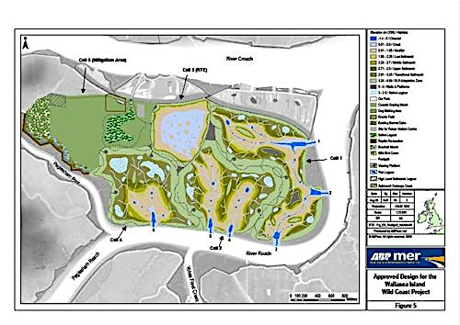
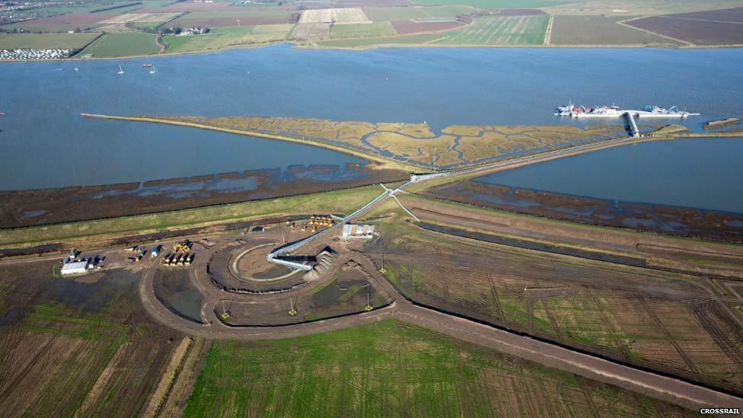
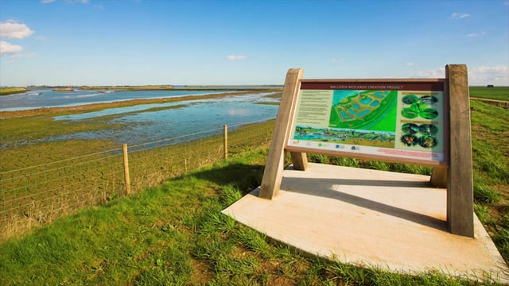
Crossrail and Wallasea Island: An example of win-wins for financial, transport and environmental considerations

Slide 8
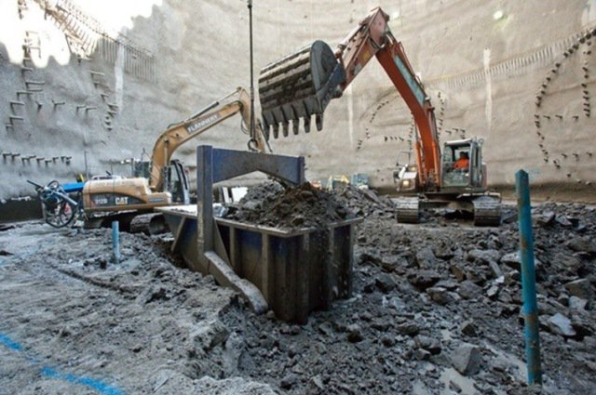
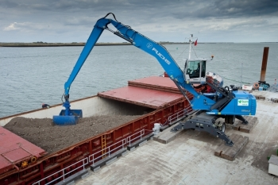
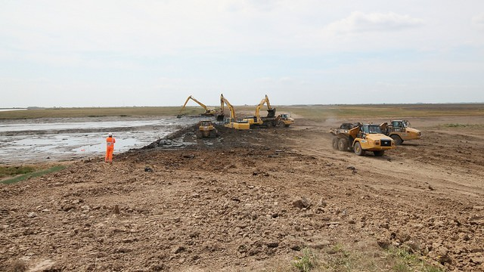
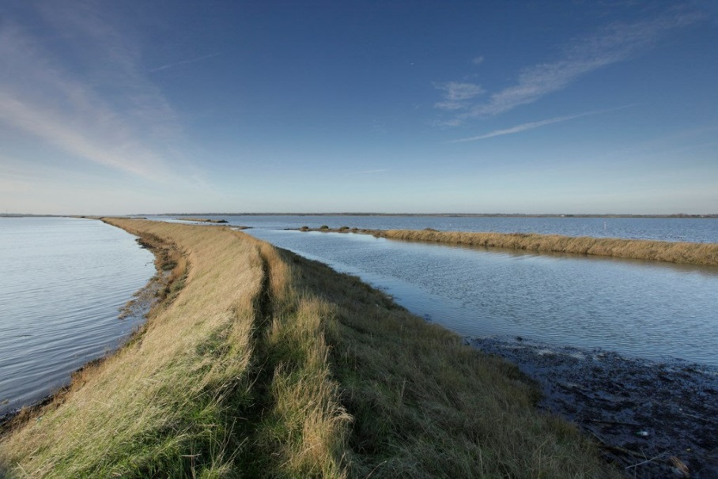
A number of quantifiable benefits were integral to the business case; and the environmental footprint a key consideration

Slide 9


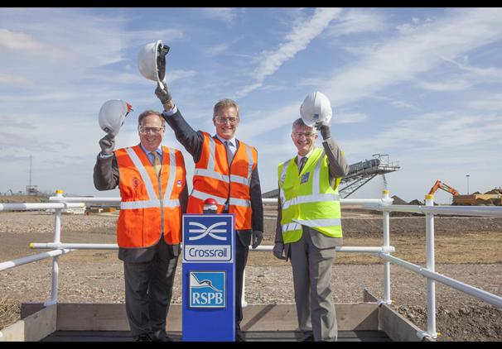
Public communication and press potential can be valuable in ensuring environmental evidence and benefits get high profile.

Slide 10
Conclusion
Embedding environmental factors in transport project commissioning most effective when:
Ensure working together to build in scientific – technical evidence early as part of strategic case and to inform different options
Ensure evidence and data inputs draw on existing guidance so can be ‘translatable’ for policy decision-makers
Identify wider benefits and good public story, but which also helps keep project costs and benefits aligned

